Slide 1
Shared Spaces
Team Members:
Heer Mehta 002190162
Kavya Mannem 002194057
Srihitha Kilari 002138766
Gunasekhar Vinugolu 001586178
Kinjal Thakkar 001568960

Slide 2
Overview
•Introduction
•Features
•Implementation
•Q & A

Slide 3
What is Shared Space?
This website is to accommodate shared office spaces for small and medium teams of size 1 to 150.
Work in the way you want to, we have individual seating spots for people who seek privacy.
Create and Customize your plan to add the amenities, accessories and services required for your team.
We also have Yoga spaces for mindfullness and improving your concentration levels, and Cafeteria for friends and colleagues to meet.

Slide 4
Unique features of Shared Office spaces
Meeting with people is always fun and informative.
Meet professionals not only from your team but also from other teams and develop your professional circle.
Gone are days where a small team has to pay for whole building and setup the professional space afresh.
Shared spaces is like cloud for data storage.

Slide 5
Features
•It is a Full Stack Application
•A simple professional space sharing application using Html, CSS, React JS, JavaScript and Bootstrap to make awesome UI, Node JS, Express Framework, MongoDB.

Slide 6
Frontend
React.JS library
JSX,
HMTL,
CSS,
SCSS

Slide 7
Backend
Node.JS – JavaScript Run time Environment
Express.JS framework

Slide 8
Database
MongoDB
Mongoose library to access MongoDB functionalities through Express.JS

Slide 9
React Hooks and Lifecycle components used
useState
useRef
useEffect
localStorage
componentDidMount()

Slide 10
Bootstrap components used
Navbar
Button
Card
Carousal
Forms etc,

Slide 11
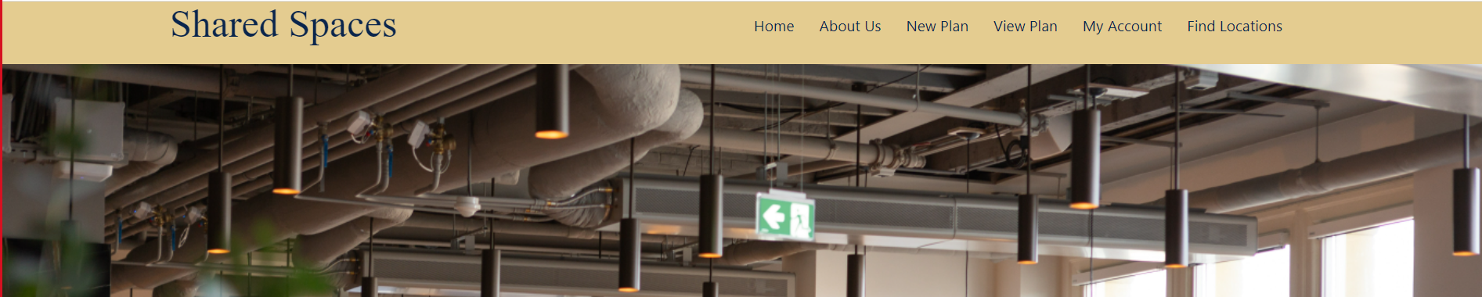
Screenshots

Slide 12
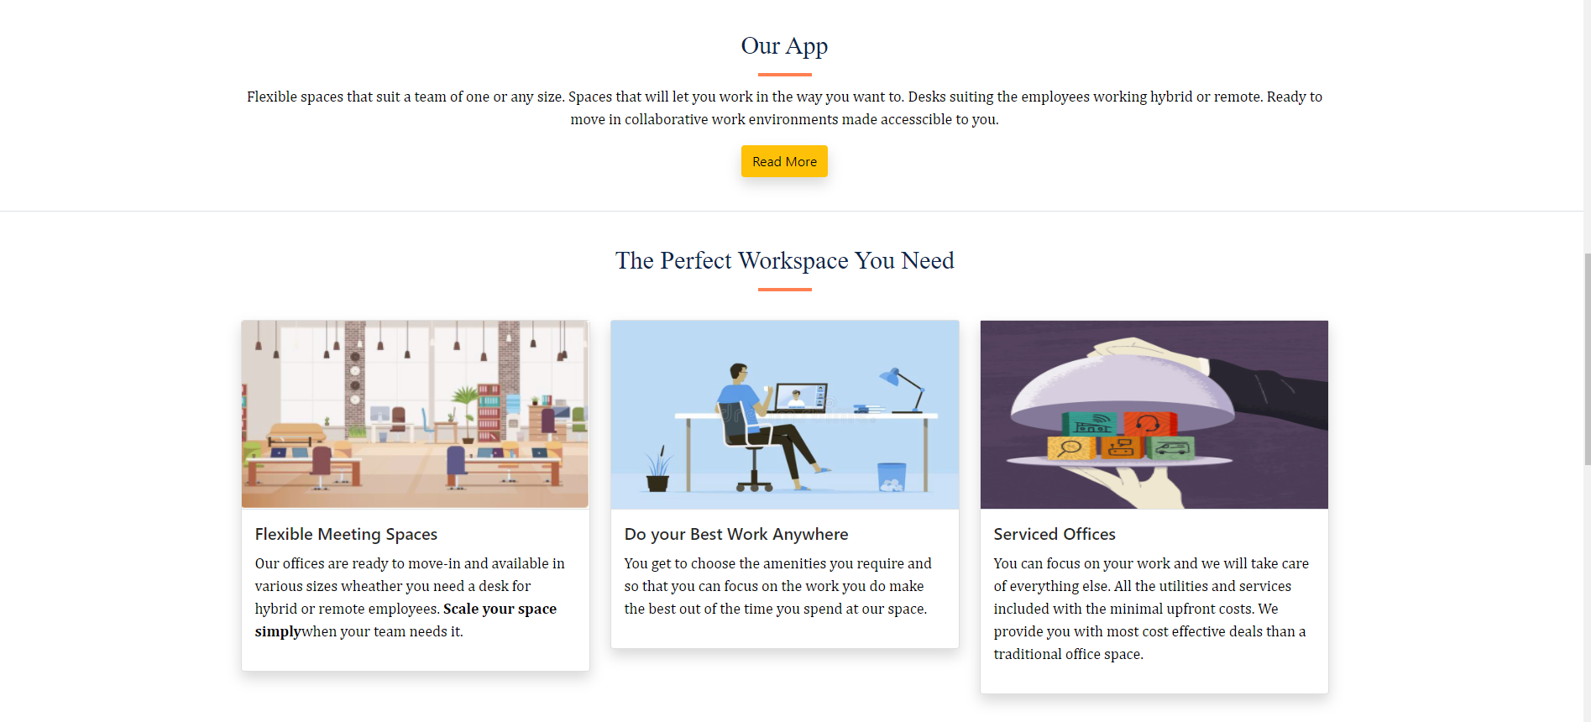
Screenshots

Slide 13
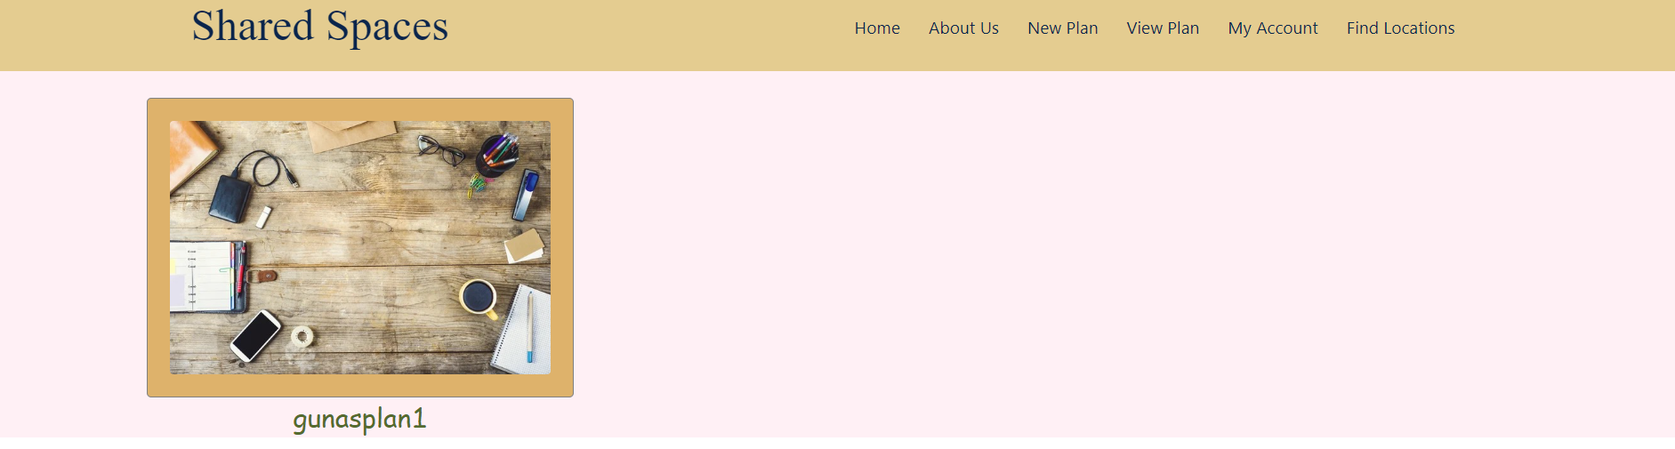
Screenshots

Slide 14
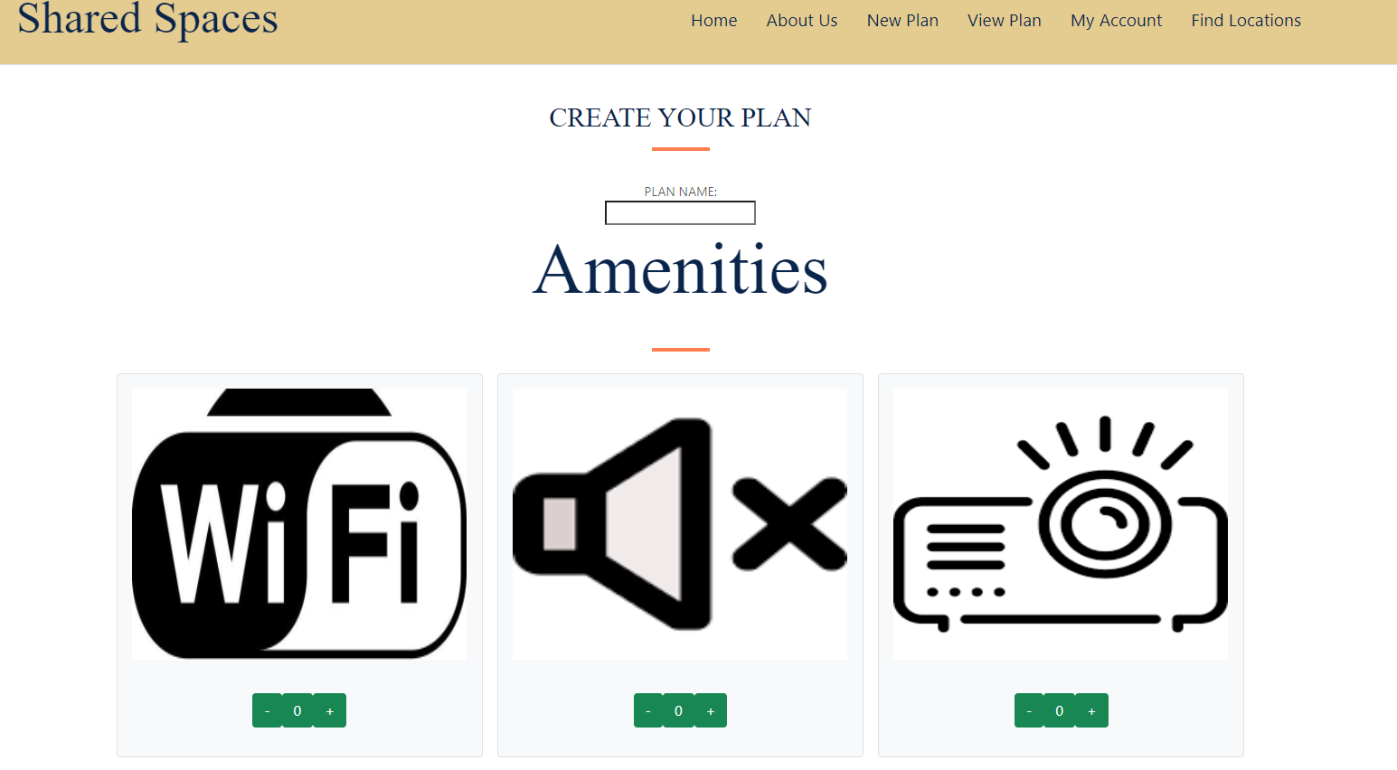

Slide 15
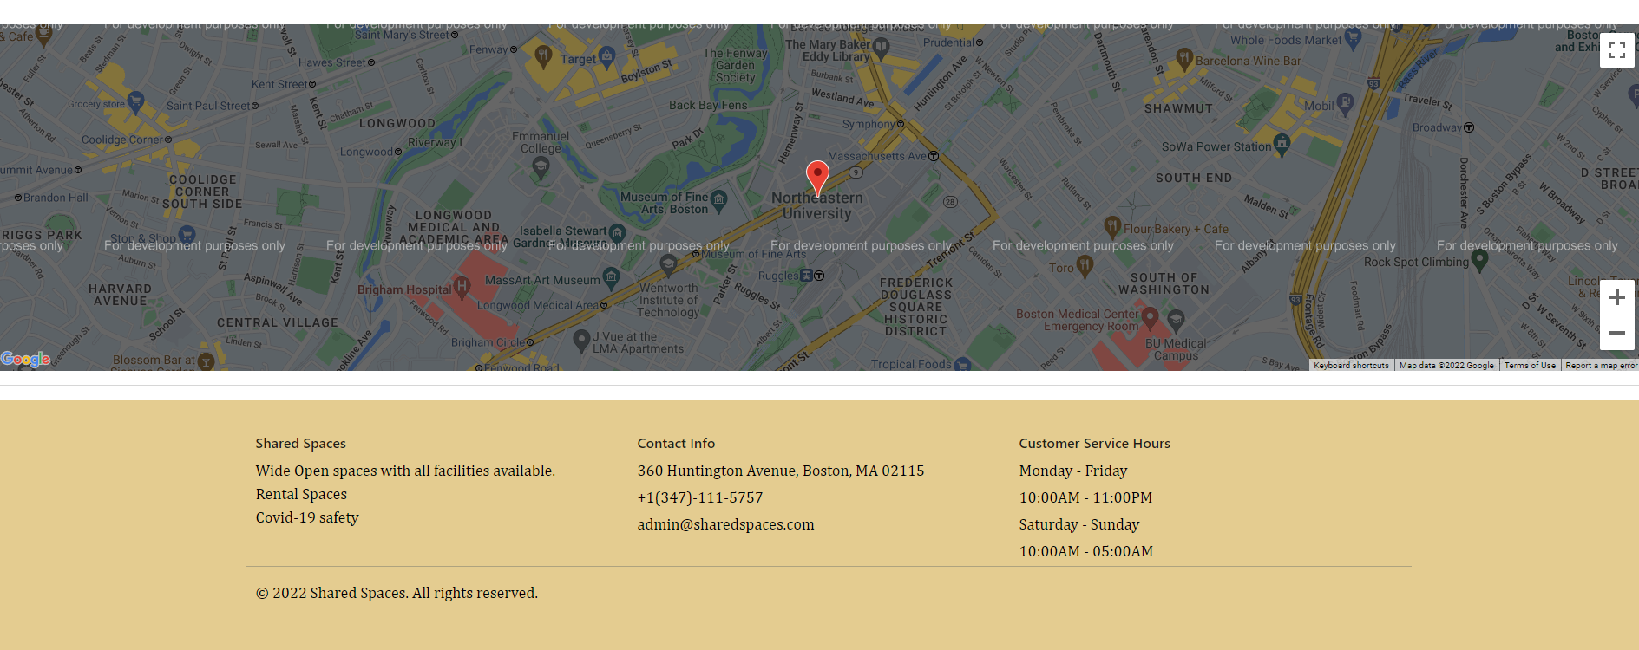
Screenshots

